Slide 1
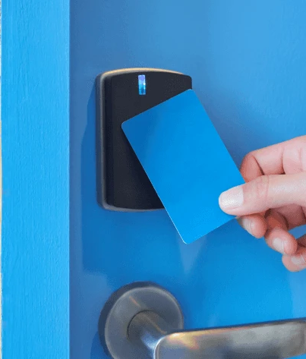
RFID in
Hotel Key Card
Kate Moreland, An Dinh, Clay Ramey
Presentation Date: April 21st, 2025
GROUP 16

Slide 2
Group Roles and Responsibilities
AN DINH
KATE MORELAND
CLAY RAMEY
Concept and Diagram Overview
State and Sequence Diagrams
Challenges and Conclusion
Introduces the RFID hotel key card system
Explains the problems it aims to solve and the motivation why we choose this topic
Provides an overview of UML diagrams
Creates and explains the State Diagram
Introduces and develops the Sequence Diagram
Refine diagrams based on team member’s feedback
Discusses potential challenges in RFID systems
Highlights room for improvement
Summarizes findings
Reviews all sections for consistency and clarity
Notes:
We divided our work based on our strengths but made sure to collaborate throughout.
An, focus on the system concept and overall diagram structure. I’ll introduce what the RFID hotel key card is and explain why it’s popular in hospitality and why we chose this topic.
Kate created and explained the State and Sequence diagrams with feedback and refine from all of us.
Clay handled the challenges in the system based on UML diagram, room for improvement, and tied everything together in the conclusion.
Throughout the process, we gave feedback and cross-reviewed each other’s work to make sure it was consistent and accurate

Slide 3
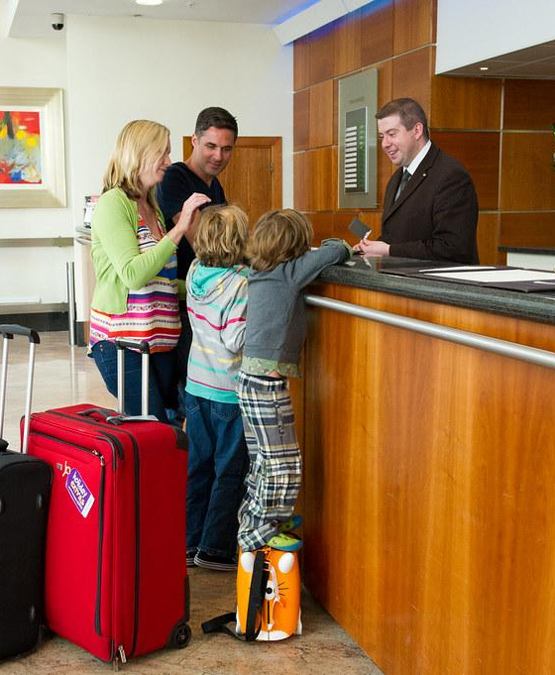
Problem Statement
Traditional hotel room systems face limitations:
Insecure:
magnetic strip cards are easy to clone
physical keys are easy to lose
Inconvenience:
lost or demagnetized cards require manual reissuance
Check-in and check-out processes are time-consuming
Outdated:
Lack of integration with modern systems
Limited support for real-time access control or remote updates
Notes:
Everyone love traveling right? You’d need a place to stay overnight so this comes to why we choose the hotel key card system to learn about. Magnetic strip card is one of many popular types that hotels usually use. However, there are some limitations of this traditional systems. First, it’s insecure as magnetic strip cards are easy to clone. Some older hotels using physical keys

Slide 4

Motivation
We decided to explore the RFID in Hotel Key Card System
It is widely used in several applications, including hospitality
Often overlooked in design education
The system use radio frequency to authenticates key cards → contactless room access and faster check-in check-out procedures
We want to explore how it offers convenience but still reduces the risk of unauthorized access
Applying UML to model a physical-digital interaction system
Helps us understand how software, hardware, and users interact in real-world applications
Gains clearer understanding of its structure, behavior, and interactions
Notes:
Explain detail how the radio frequency happens

Slide 5


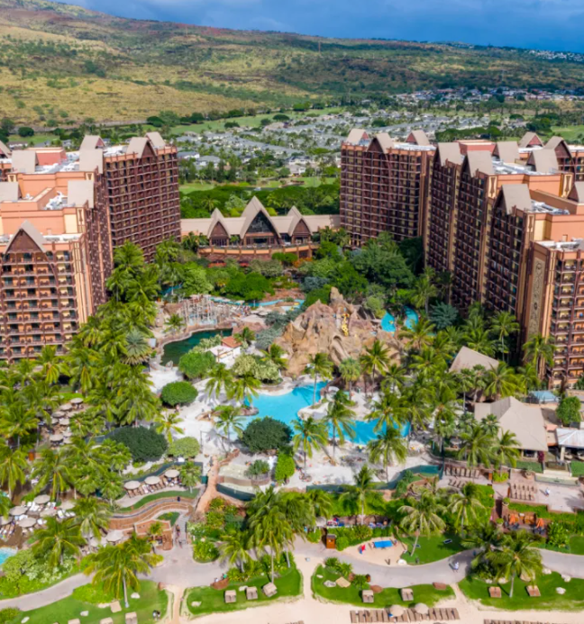
Real-world examples
Marriott International
Disney Resorts
Hilton Hotels
Uses RFID key cards as standard method of access control for most of their properties
Provides RFID keycards
Guests can use smartphones as digital keys through Hilton Honors app
MagicBands: Disney’s RFID-enabled wristbands serve as hotel room keys, park tickets, and payment methods

Slide 6
Diagrams Overview
State Diagram
Sequence Diagram
A state diagram allows to represent the life cycle of an object. This is useful to help see the flow of a system.
⇒ best to demonstrate how the RFID key card transitions through different states
A sequence diagram illustrates how objects interact with each other over their lifetime.This diagram illustrates how objects interact over time.
⇒ essential for showing how a card is issued, used, and deactivated.
Notes:
State diagram provides an easy-to-understand, visualization of the key lifecycle. It also shows the transition between states. Sequence diagram shows the order of messages between actors and objects. We’ll go into details soon.

Slide 7
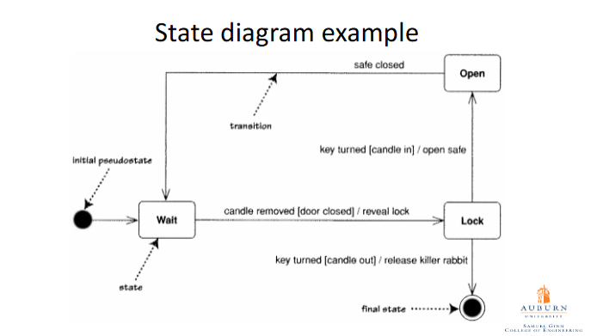
Creating a State Diagram
Dissect the object and how it works
Identify the states that are present
Find the events and triggers which will cause the transitions from one state to the next
Illustrate the transitions via arrows
Make sure to out in the initial and final states
From slides Lec3.pdf

Slide 8
Parts of Our State Diagram
States:
Created
Used
Expired
Invalid
Reactivated
Deactivated
Transitions:
Activation at Check-in
Expiry after Checkout or Time Limit
Staff Deactivates Card
Manual Invalidation
Reissue for Lost Cards
Activate Card
The state diagram shows that the key cards through state transitions: new -> activated -> in use -> expired -> invalidated.

Slide 9
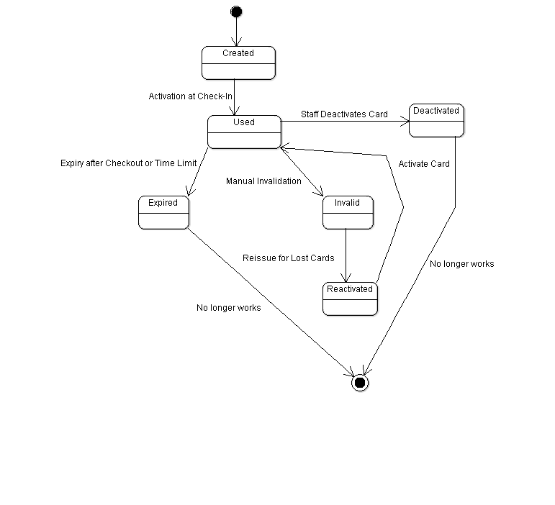
Notes:
Better

Slide 10
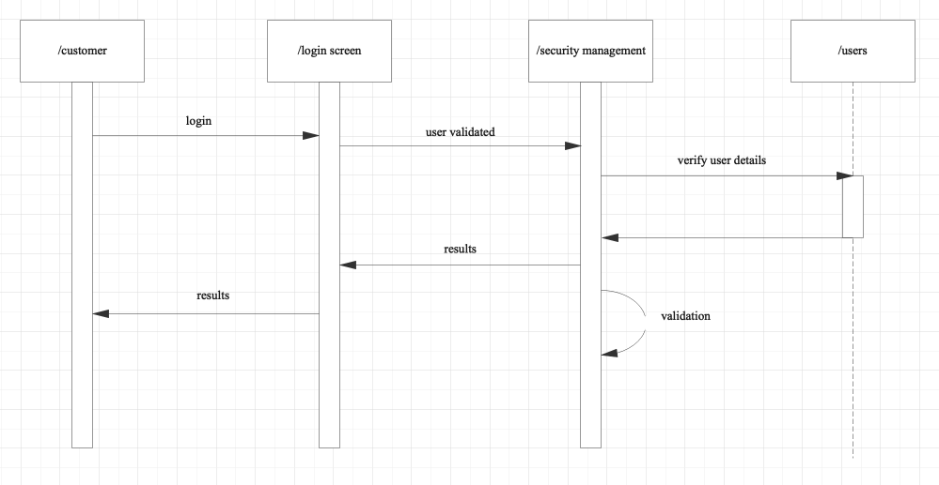
Creating a Sequence Diagram
Locating the actors (external items)
Locating the objects (parts of the system)
Lifelines (vertical dashed lines that show the lifetime)
Messages (call, send, create, destroy)
Activation Bars (rectangles on lifelines to show if they are active)
Return Messages (dashed arrows represent return from call function)
https://images.edrawmax.com/images/knowledge/sequence-diagram-example-1.png

Slide 11
Parts of Our Sequence Diagram
Actors:
Guest
Staff
Objects:
Front Desk System
Admin Backend
Key Card
Room Lock
Messages:
requestCheckIn
enterGuestDetails
createKeyCard
writeCardData
swipeCard
validateCard
checkoutGuest
deactivateCard
expireCard
Return Messages:
cardCreated
accessGranted
accessDenied

Slide 12
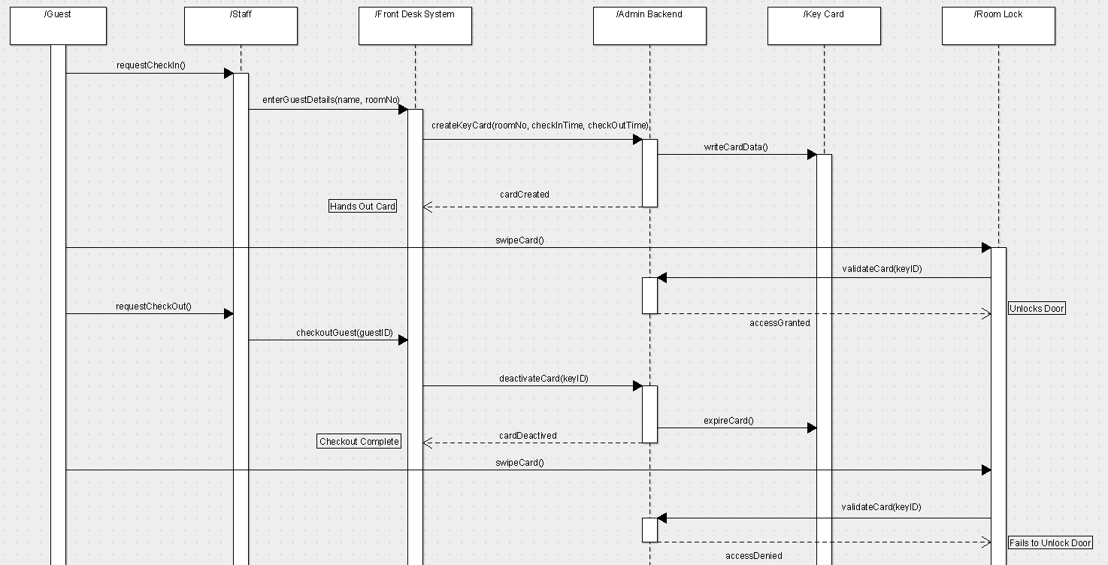

Slide 13
Challenges
Security Vulnerabilities
RFID key cards can be cloned for unauthorized access if the encryption is weak
The RFID key card signals may be intercepted or relay attacks could add risk if proper authentication protocols are not followed
Operation Limitations
Cost of Implementation
System failures like a server being down could disrupt access control. This could leave guests locked out.
To many signal interfaces close together could affect the RFID cards functionality
Transitioning from a traditional key system to a RFID system is very expensive
There is also maintenance costs. You must train staff on the system and maintain the server

Slide 14
Proposed Improvement
Mobile App RFID
Enhance Security
Enabling smartphone-based RFID access removes the need for physical cards
This would allow the hotel to monitor card usage in real time
Adding a multi-factor authentication, such as text message verification
Use of dynamically generated encryption keys that change periodically would stop card cloning
Guest Personalization
Fail Safe and Redundancy
Implement guest-specific privileges through the RFID system
Guests can access additional facilities based on paid amenities, or not be allowed to enter these facilities if unpaid
Having backup ways of access in case of system failures such as door codes or physical keys for entrance
Storing guest data locally would allow for room access even during network outages

Slide 15
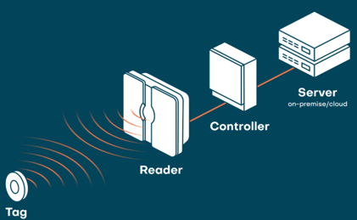
Conclusion
The RFID hotel key cards provide an advanced solution to the traditional access challenges by improving security and streamlining guest check-in and room access
Security vulnerabilities and system failures can be managed through fail safes, multi-factor authentication, redundancy, and dynamic encryption key generation
Integrating the RFID key cards into mobile applications on a network allow for real time monitoring of key card use, failures, and suspicious activity
With the state diagram we break down the RFID key cards life cycle into a sort of map. The sequence diagram illustrates the order between guests, staff, front desk systems, backend administration, key cards, and room locks.
⇒ These diagrams help understand the cycle and flow of the RFID life cycle

Slide 16
References
https://frontdesksupply.com/hotel-proximity-cards-with-rfid/
https://hotelandresortkeycards.com/collections/marriott-ulc-rfid-key-cards-compatible-with-security-upgraded-onity-dormakaba-and-saflok-stems
https://www.rfidcard.com/the-development-of-rfid-hotel-cards-whats-next-in-the-future/?srsltid=AfmBOopdvYoDfECYuHBkZaSRkRkuWQVr03-v3Cd5gewZHsJ5qFtOrqo0
https://www.atlasrfidstore.com/rfid-insider/9-ways-disney-uses-rfid-nfc-technology-disneys-continued-rfid-success/?srsltid=AfmBOoqP91VSpfwvUHjUvlFJ66DiPICu3pIItK-94v1vdgWZBtzmt3qE
https://www.geeksforgeeks.org/unified-modeling-language-uml-sequence-diagrams/
https://developer.ibm.com/articles/the-sequence-diagram/
https://youtu.be/FwbWvjq_iiM
https://youtu.be/js0865uovTM
https://images.edrawmax.com/images/knowledge/sequence-diagram-example-1.png

Slide 17
Thank you for listening!
Do you have any question?

